Slide 1
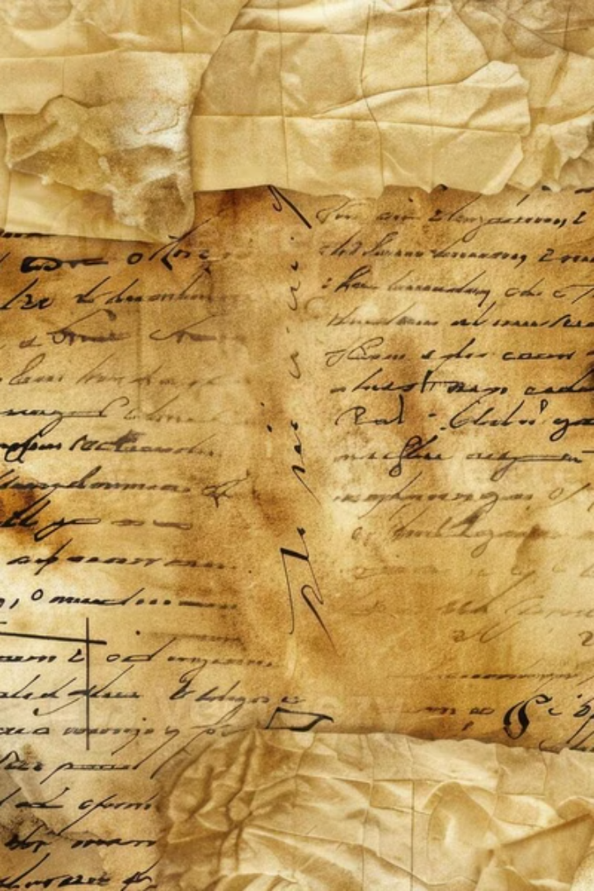
Handwritten Text Recognition Project
This project aims to develop a robust system for accurately transcribing handwritten text, addressing the challenges of digitizing historical documents and processing handwritten forms. Our system targets researchers, developers, and end-users, offering a streamlined solution for converting handwriting into digital text. The high-level architecture involves image input, preprocessing, feature extraction, recognition, and text output.

Slide 2
Data Collection and Preprocessing
Datasets
Data Augmentation
MNIST
Rotation
IAM Handwriting Database
Scaling
EMNIST
Skewing
Custom datasets
Noise addition
Extensive datasets were employed to train the model, ensuring variability and robustness.
Augmentation techniques expanded the dataset, improving the model's generalization.
Our approach involves a comprehensive data collection and preprocessing stage. We utilize established datasets such as MNIST, IAM Handwriting Database, EMNIST, and custom datasets. Data augmentation techniques, including rotation, scaling, skewing, and noise addition, enhance the model's robustness. Preprocessing steps involve grayscale conversion, binarization, noise reduction, and slant correction, implemented using tools like OpenCV and Scikit-image.

Slide 3
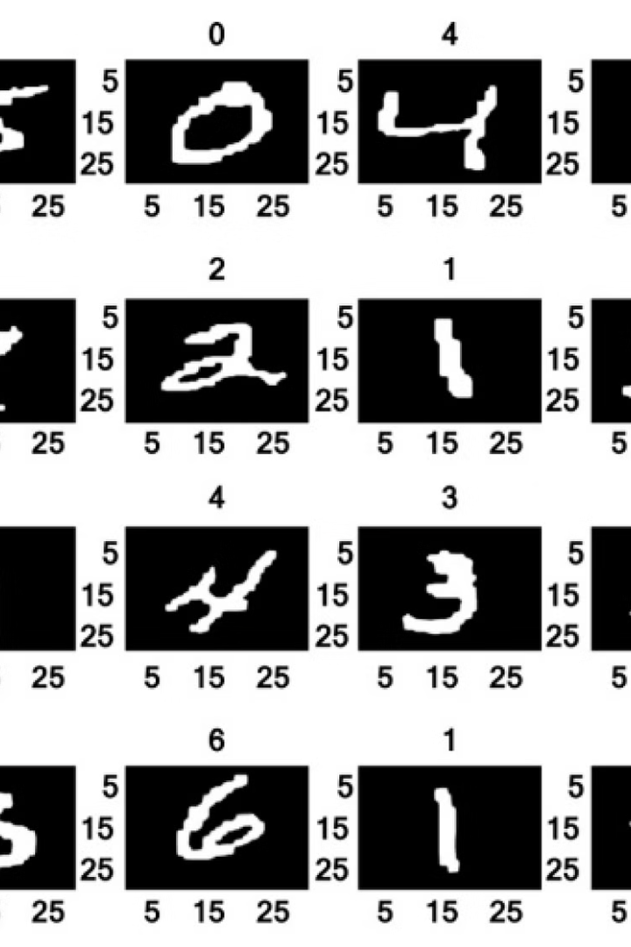




Model Architecture
RNNs with LSTM
Recurrent Neural Networks provide sequential processing
CTC Loss Function
Connectionist Temporal Classification for unsegmented data
CNNs for Feature Extraction
Convolutional Neural Networks extract relevant features
Hybrid CNN-RNN
Combining CNNs and RNNs for enhanced performance
The model architecture employs Recurrent Neural Networks (RNNs) with Long Short-Term Memory (LSTM) cells, crucial for processing sequential data. The Connectionist Temporal Classification (CTC) loss function handles unsegmented data effectively. Convolutional Neural Networks (CNNs) are used for feature extraction, and hybrid CNN-RNN architectures, such as CRNN, are implemented. These benchmarks help attain state-of-the-art accuracy.

Slide 4
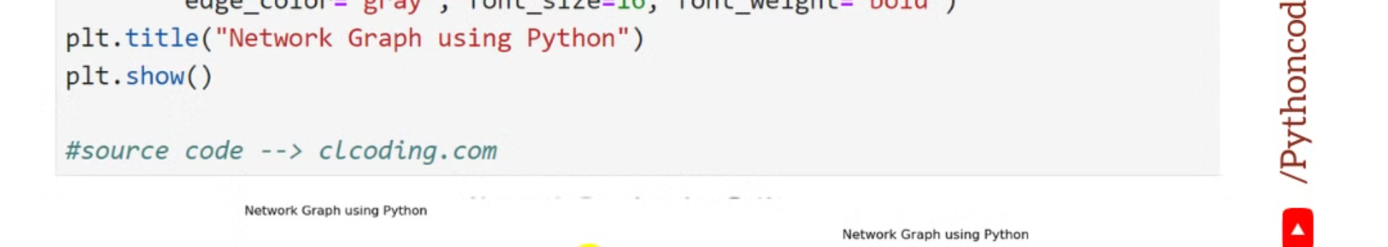
Training Process
1
Environment
2
Optimizer
Python, TensorFlow, PyTorch
Adam optimizer
3
Learning Rate
4
Regularization
ReduceLROnPlateau
Dropout, L1/L2 regularization
The training environment includes Python, TensorFlow, and PyTorch, providing flexibility and robust support. We utilized the Adam optimizer for efficient convergence and implemented learning rate scheduling using ReduceLROnPlateau. Regularization techniques such as Dropout and L1/L2 regularization were applied to prevent overfitting. The batch size ranged from 32 to 64.

Slide 5
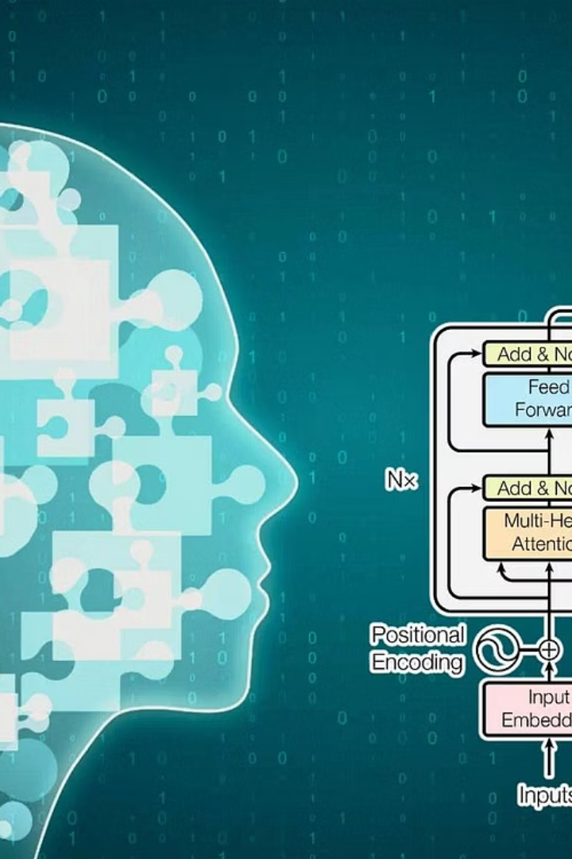



Evaluation Metrics
CER
Character Error Rate is the primary metric.
WER
Word Error Rate is the secondary metric.
Dataset Split
Training (80%), Validation (10%), Testing (10%).
Evaluation of the model's performance is critical. The Character Error Rate (CER) is our primary metric, with the Word Error Rate (WER) as a secondary measure. The dataset is split into Training (80%), Validation (10%), and Testing (10%) sets to ensure robust assessment. The baseline accuracy was approximately 60%, while we achieved accuracy greater than 90% on specific datasets.

Slide 6
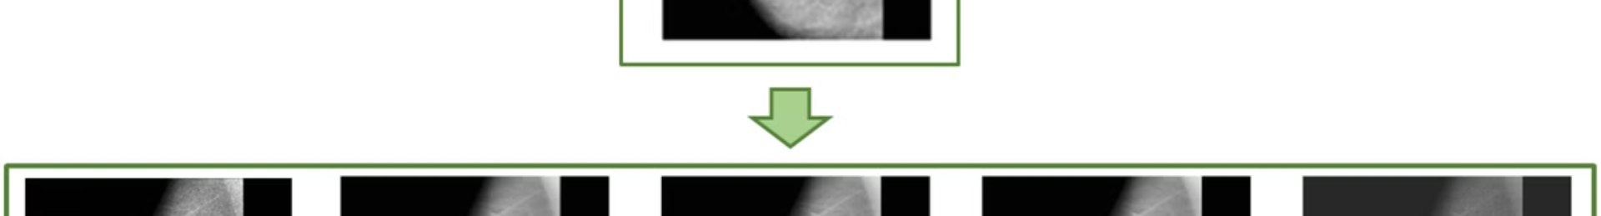
Challenges and Solutions
Variability in Handwriting
1
Data augmentation and robust feature extraction techniques were implemented.
2
Noise in Scanned Documents
Image preprocessing techniques effectively reduced noise.
Limited Training Data
3
Transfer learning and synthetic data generation were utilized.
4
Computational Complexity
Model optimization and hardware acceleration (GPUs) were applied.
Several challenges were addressed during the project. Variability in handwriting styles was mitigated through data augmentation and robust feature extraction. Noise and artifacts in scanned documents were reduced using image preprocessing techniques. Limited training data was augmented via transfer learning and synthetic data generation. Computational complexity was managed through model optimization and hardware acceleration using GPUs.

Slide 7
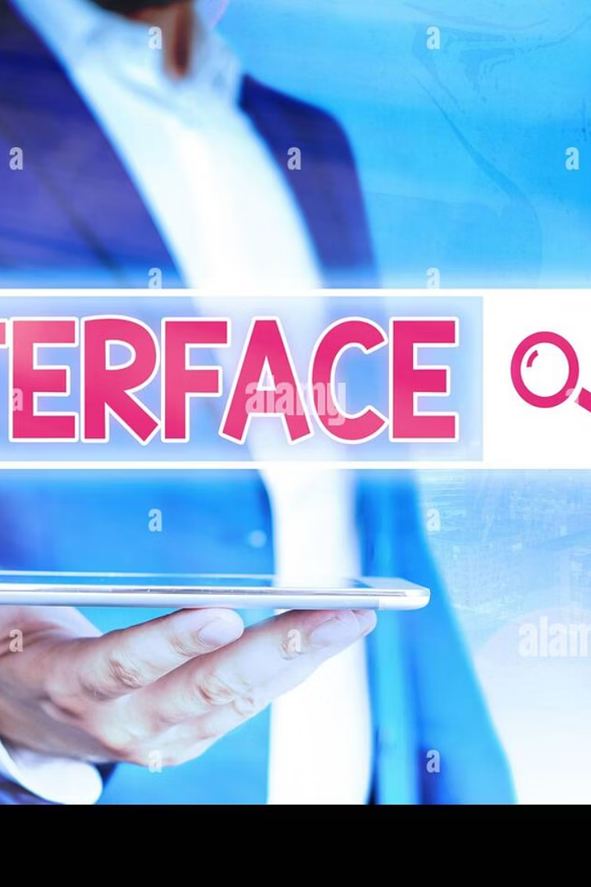
Future Directions
Accuracy on Low-Resource Languages
End-to-End Trainable Models
Improving performance for languages with limited data.
Developing models that require less manual preprocessing.
Integration with Document Systems
Enhancing document understanding and automation.
Future work includes improving accuracy on low-resource languages, developing end-to-end trainable models, and integrating the system with document understanding platforms. Deployment on mobile and embedded devices is also planned, with a focus on real-time applications. These directions aim to enhance the system's versatility and practical utility.

Slide 8



Conclusion
Accurate System
1
High accuracy achieved
Effective Deep Learning
2
Demonstrated effectiveness
Opportunities Opened
3
Further development
In conclusion, this project successfully developed a high-accuracy handwritten text recognition system. The effectiveness of deep learning techniques for this task was clearly demonstrated. This work opens opportunities for further research and development in document processing, paving the way for more efficient and accurate text recognition solutions.

